Slide 1

Lecturer: Henning (Enric) Garcia Torrents, M.Sc.
Affiliation: PhD candidate, researcher and professor in training, Medical Anthropology Research Center, Universitat Rovira I Virgili (Tarragona, Spain).
Funding: Financed by a Professor in Training grant by the Spanish Ministry of Science, Innovation and Universities. Further fundings from EU COST science and technology coordination, and a research project to map autonomy-fostering initiatives in mental health by the Spanish Ministry of Science, Innovation and Universities.
Title of the lecture:
Psychoneuroimmunology, Mental Health, and the Endocrine System: Stress, Trauma, and Metabolic Dysregulation: an Integrative and Holistic Approach to Clinical Practice

Slide 2
Psychoneuroimmunology, Mental Health, and the Endocrine System: Stress, Trauma, and Metabolic Dysregulation
An Integrative and Holistic Approach to Clinical Practice
Learning Objectives:
Understand the key interactions between the nervous, endocrine, and immune systems.
Recognize the impact of stress and trauma on mental and physical health.
Apply integrative approaches to clinical management of related conditions.

Slide 3
What is Psychoneuroimmunoendocrinology (PNIE)?
Definition: The study of interactions between the nervous, endocrine, and immune systems in health and disease​​.
Clinical relevance: How stress and trauma dysregulate these systems, and what interventions are advisable from this integrative perspective.

Slide 4
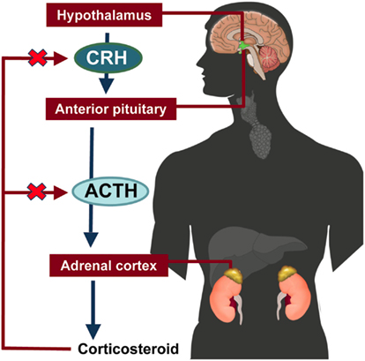
The Neuroendocrine-Immune System
in Health and Disease
Key Players in PNIE
Hypothalamic-Pituitary-Adrenal (HPA) Axis
Sympathetic-Adrenal-Medullary (SAM) Axis
Cytokines and neuroinflammation
Microbiota-Gut-Brain Axis​

Slide 5
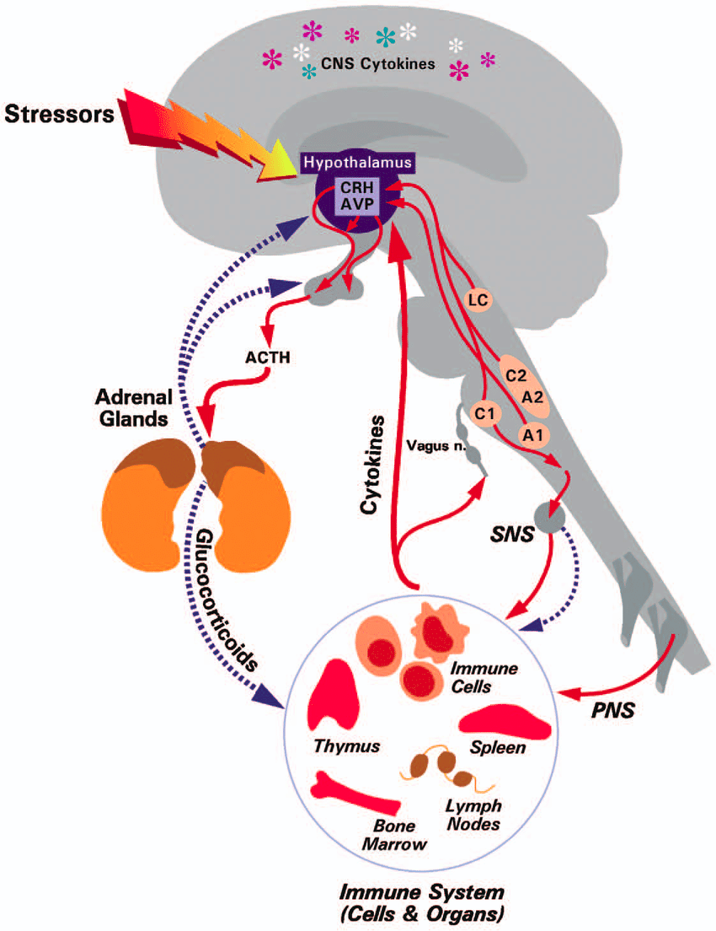
The Neuroendocrine-Immune System
in Health and Disease
Stress and the HPA Axis
Acute vs. chronic stress responses
Cortisol and its role in immune regulation​
Dysregulation in psychiatric and metabolic disorders

Slide 6
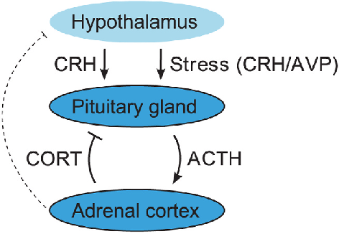
The Neuroendocrine-Immune System
in Health and Disease
Stress and the HPA Axis
Acute vs. chronic stress responses
Cortisol and its role in immune regulation​
Dysregulation in psychiatric and
metabolic disorders

Slide 7
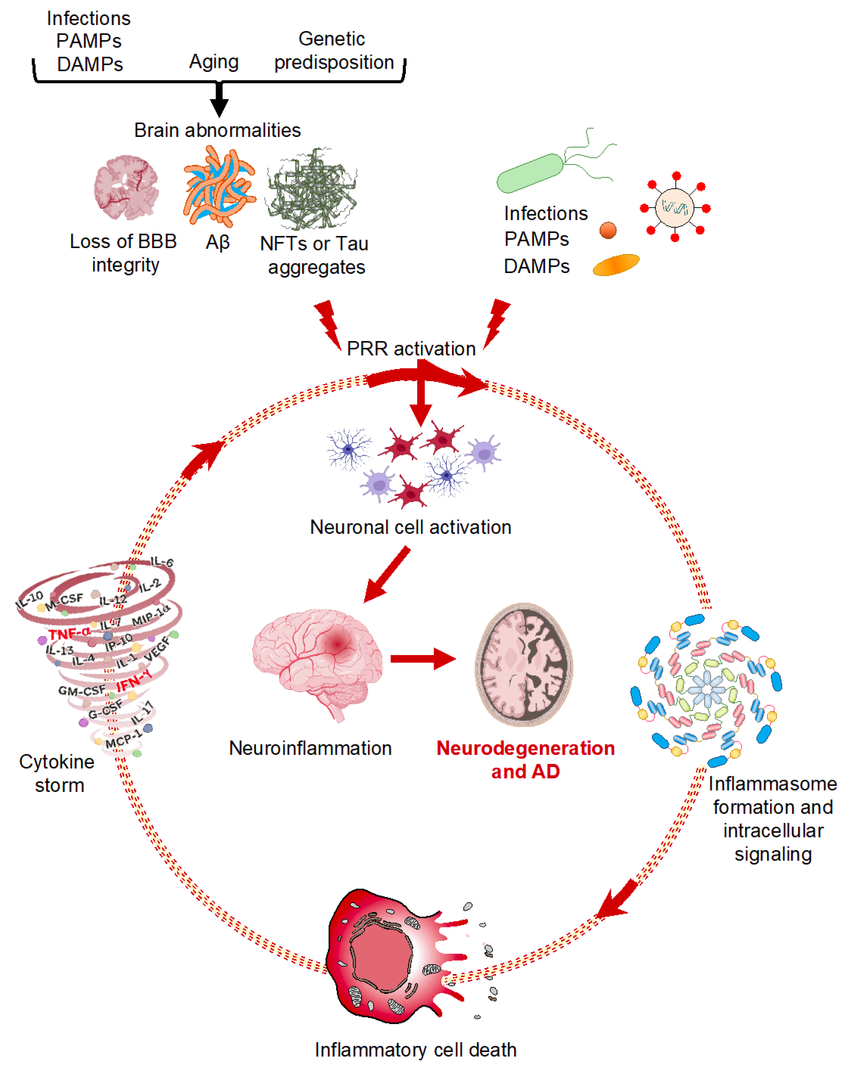
Immune Activation & Neuroinflammation
Role of pro-inflammatory cytokines
(IL-1β, TNF-α, IL-6)
How inflammation affects brain function
and mood disorders​

Slide 8
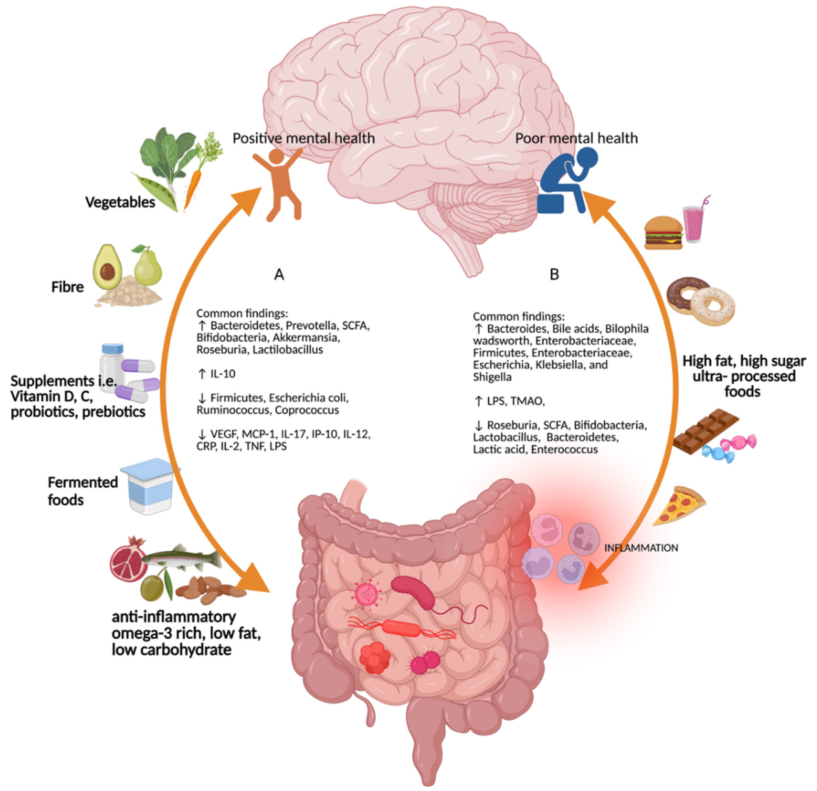
The Gut-Brain-Immune Connection
Microbiota and mental health
Leaky gut and systemic inflammation

Slide 9
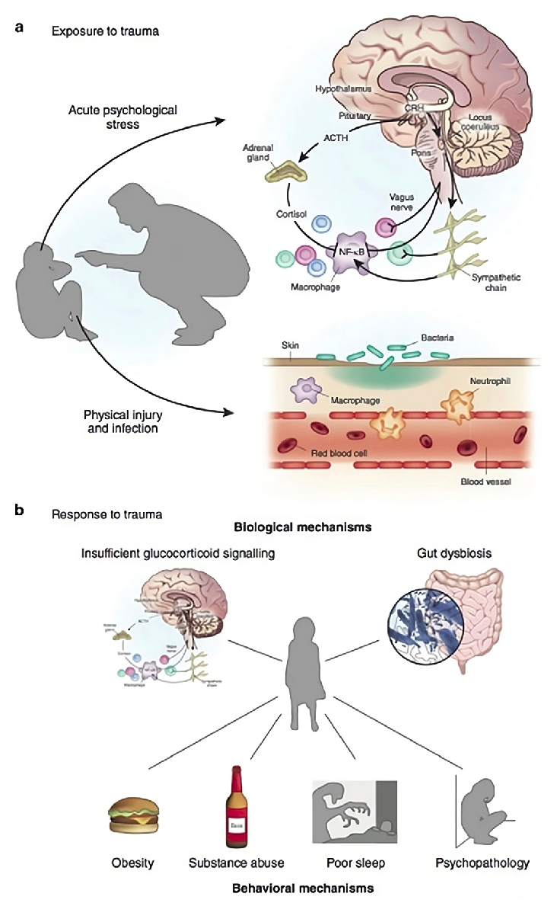
The Impact of Stress and Trauma
on Mental and Physical Health
Childhood Trauma and Lifelong Health Risks
Early-life stress increases risk for:
Depression, PTSD, schizophrenia
Autoimmune disorders (lupus, rheumatoid arthritis)
Metabolic syndrome and diabetes

Slide 10
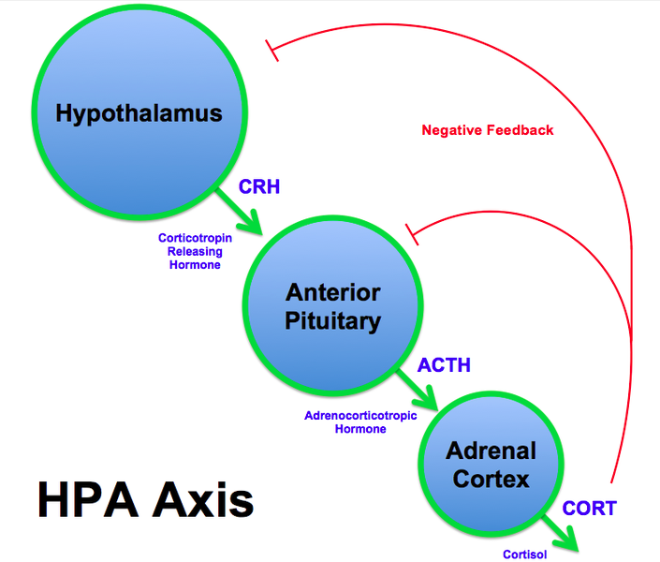
The Impact of Stress and Trauma
on Mental and Physical Health
PTSD as a Psychoneuroimmune Disorder
Hyperactive amygdala, reduced prefrontal control
Chronic inflammation & altered cortisol responses​

Slide 11
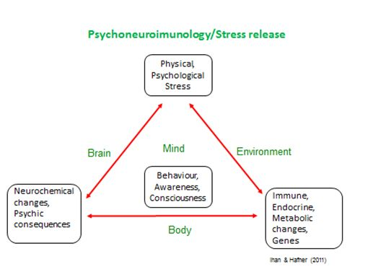
The Impact of Stress and Trauma
on Mental and Physical Health
Depression, Anxiety, and Inflammatory Markers
Elevated CRP, IL-6, TNF-α in
major depression​
Anti-inflammatory treatments
as potential therapies

Slide 12
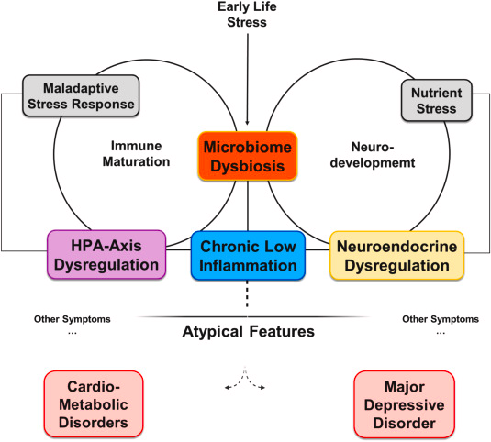
The Impact of Stress and Trauma
on Mental and Physical Health
Metabolic Dysregulation in Mental Illness
Insulin resistance, obesity,
and psychiatric comorbidities
Role of glucocorticoids and cytokines
in metabolic disease​

Slide 13
Clinical Applications – A Holistic Approach
Integrative and Holistic Management Strategies
Lifestyle modifications: Sleep, diet, and physical activity
Mind-body approaches: Mindfulness, yoga, and cognitive therapy
Targeted interventions: Anti-inflammatory treatments, microbiota-based therapies

Slide 14
Clinical Applications – A Holistic Approach
Psychoneuroimmune Treatments in Clinical Practice
Anti-inflammatory strategies: Omega-3, NSAIDs, cytokine blockers
Microbiome-based interventions: Probiotics, fiber, psychobiotics
HPA-targeted treatments: Adaptogens, stress reduction therapies​

Slide 15
Clinical Applications – A Holistic Approach
Case Study – Depression, Inflammation, and Endocrine Dysfunction
Patient Profile and clinical findings:
Age/Gender: 45-year-old female​
Medical History: Major Depressive Disorder (MDD)​
Inflammatory Markers: Elevated levels of pro-inflammatory cytokines (e.g., IL-6, TNF-α)​
Endocrine Assessment: Hyperactivity of the Hypothalamic-Pituitary-Adrenal (HPA) axis; increased cortisol secretion​

Slide 16
Clinical Applications – A Holistic Approach
Case Study – Depression, Inflammation, and Endocrine Dysfunction
Intervention and outcome:
Administration of anti-inflammatory agents alongside standard antidepressant therapy​
Significant reduction in depressive symptoms and normalization of inflammatory markers​ beyond standard results with treatment as usual. Improved Response and Remission Rates.
Reference:
Slavich, G. M. (2019). Psychoneuroimmunology of stress and mental health. In K. Harkness & E. P. Hayden (Eds.), The Oxford handbook of stress and mental health. Oxford University Press.​​

Slide 17
Conclusion & Takeaways
Summary of Key Concepts
PNIE is essential for understanding stress-related diseases.
Chronic inflammation links mental and metabolic disorders.
Holistic treatment approaches are key for effective management.

Slide 18
Conclusion & Takeaways
Final Thoughts – Future Directions in PNIE Research
Personalized medicine and biomarkers for psychiatric and other conditions
Expanding microbiome-based and other therapies in clinical practice

Slide 19
References
Bottaccioli, F., & Bottaccioli, A. G. (2020). Psychoneuroendocrine immunology and science of the integrated care: The manual. Edra S.p.A.
Ortega, M. A., García-Montero, C., Fraile-Martinez, O., Álvarez-Mon, M. A., Gómez-Lahoz, A. M., Lahera, G., ... Álvarez-Mon, M. (2022). Immune-mediated diseases from the point of view of psychoneuroimmunoendocrinology. Biology, 11(7), 973. https://doi.org/10.3390/biology11070973
Raony, Í., de Figueiredo, C. S., Pandolfo, P., Giestal-de-Araujo, E., Oliveira-Silva Bomfim, P., & Savino, W. (2020). Psycho-neuroendocrine-immune interactions in COVID-19: Potential impacts on mental health. Frontiers in Immunology, 11, 1170. https://doi.org/10.3389/fimmu.2020.01170
Fraile-Martinez, O., García-Montero, C., Álvarez-Mon, M. Á., Casanova-Martín, C., Fernández-Faber, D., Presa, M., ... Ortega, M. A. (2025). Grasping post-traumatic stress disorder (PTSD) from the perspective of psychoneuroimmunoendocrinology (PNIE): Etiopathogenic mechanisms and relevance for the integrative management. Biological Psychiatry. https://doi.org/10.1016/j.biopsych.2025.01.014
Slavich, G. M. (2019). Psychoneuroimmunology of stress and mental health. In K. Harkness & E. P. Hayden (Eds.), The Oxford handbook of stress and mental health. Oxford University Press. https://doi.org/10.1093/oxfordhb/9780190681777.013.24

